Slide 1

Link to video presentation
https://drive.google.com/file/d/1tuRAxBpkJo7qrLpCjMaZAbITkvxpkzWb/view?usp=sharing

Slide 2
DTE-2502 – Neural Networks Graded Assignment 02 Deep RL Agents
Nov 2023
Ingrid Ledingham

Slide 3
Contents
1. Assignment
2. DQN agent – theory
3. DQN agent - implementation
4. Results
5. Learning Points

Slide 4
1. Assignment
Goals of the assignment
To create Deep Q Learning Agent that can learn how to play the game “Snake”.
To train the agent for 200 000 iterations. DQN models take a long time before they learn.
Goals and rules of the Snake game
The agent acts as a snake moving non-stop through a 2 dimentional grid
The goal of the game is to collect as many apples as possible inside the grid, growing the snake until it reaches the biggest possible size inside the grid.
If you hit a wall or the snake runs into itself it lose the game

Slide 5
2. DQN agent theory
DQN theory:
Definition of a Deep Q Learning agent:
”A value-based reinforcement algorithm that trains a critic to estimate the expected discounted cumulative long-term reward when following the optimal policy.” (MathWorks, 2023)
Description:
An algorithm that uses Q values and a replay buffer to remember samples of its previous moves. Starts with more exploration to begin with, then adjusts to exploitation as can harvest memories from the Replay Buffer.

Slide 6
2. DQN agent theory
DQN theory:
Transitions through its tasks using actions, state, next state, rewards and a check if done,
Starts by initializing model with parameters
Choose action - random action in the beginning, then more and more policy based– (exploration vs. exploitation)
Performs action
Measures the reward
Updates the q-value and train model (with loss function)
+ repeat
If done = experience replay (it trains itself on all previous experiences)
The goal is to maximise the reward score

Slide 7
3. DQN agent implementation
How does DQN work in the “Snake” game?
We use two neural networks– a target network (DeepQLearningAgent) and one for the evaluation network (AdvantageActorCriticAgent). This is how the DQN agent trains itself while playing the game.
We predict actions with Q-values using the evaluation network
(AdvantageActorCriticAgent) creating the best long term policy for the agent.

Slide 8
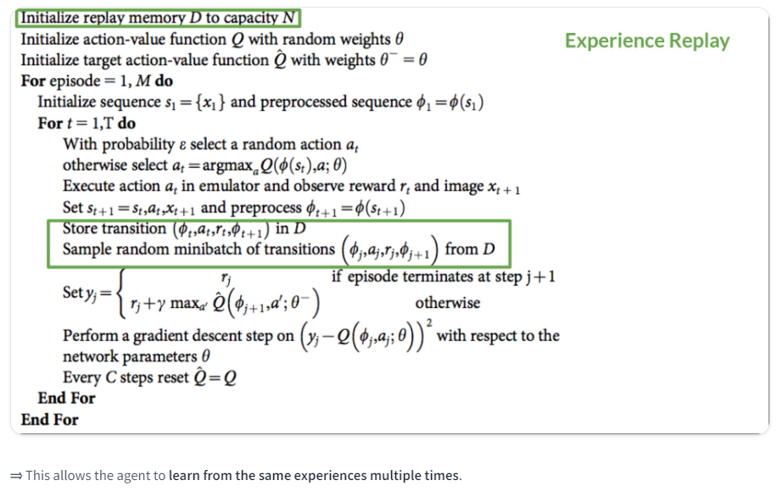
2. DQN agent theory

Slide 9
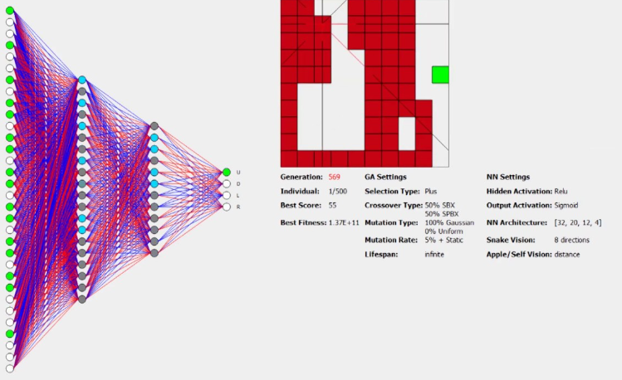
2. DQN agent theory
From Chrispresso (2019), «AI Learns how to play Snake»

Slide 10
3. DQN agent implementation
Code structure:
agent.py – Pytorch agent of the two neural networks using version 17.1 (DeepQLearningAgent and AdvantageActorCriticAgent)
game_environment.py – The game environment where the snake classes are a part of the environment
replaybuffer.py – ReplayBuffer to store random samples of transitions
training.py – training loop
Trained model - Saved in models\17.1
Model name: model_200000.pt (Pytorch) or model_200000.h5 (Tensorflow)

Slide 11
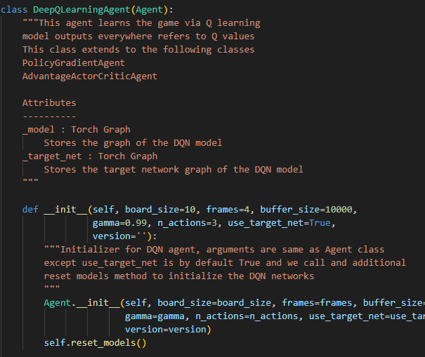
3. DQN agent implementation:
DQN agent in agent.py

Slide 12
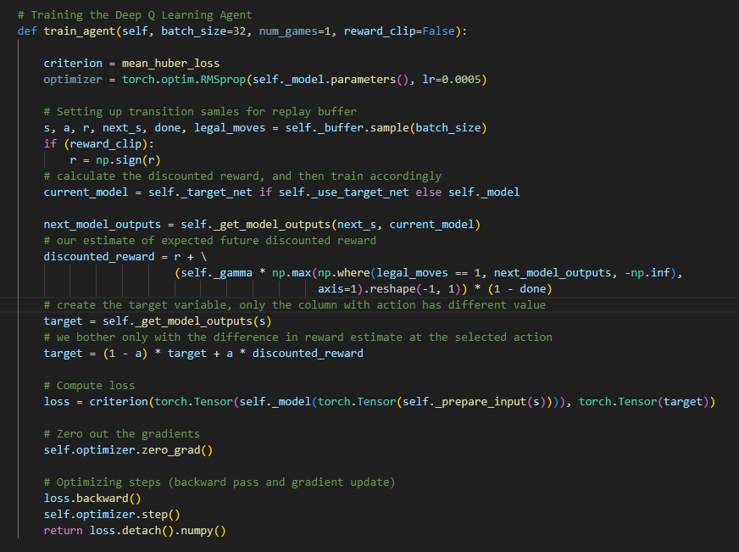
3. DQN agent implementation:
Deep q learning
with experience replay
Notes:
Target network updates in function def_update_target network

Slide 13
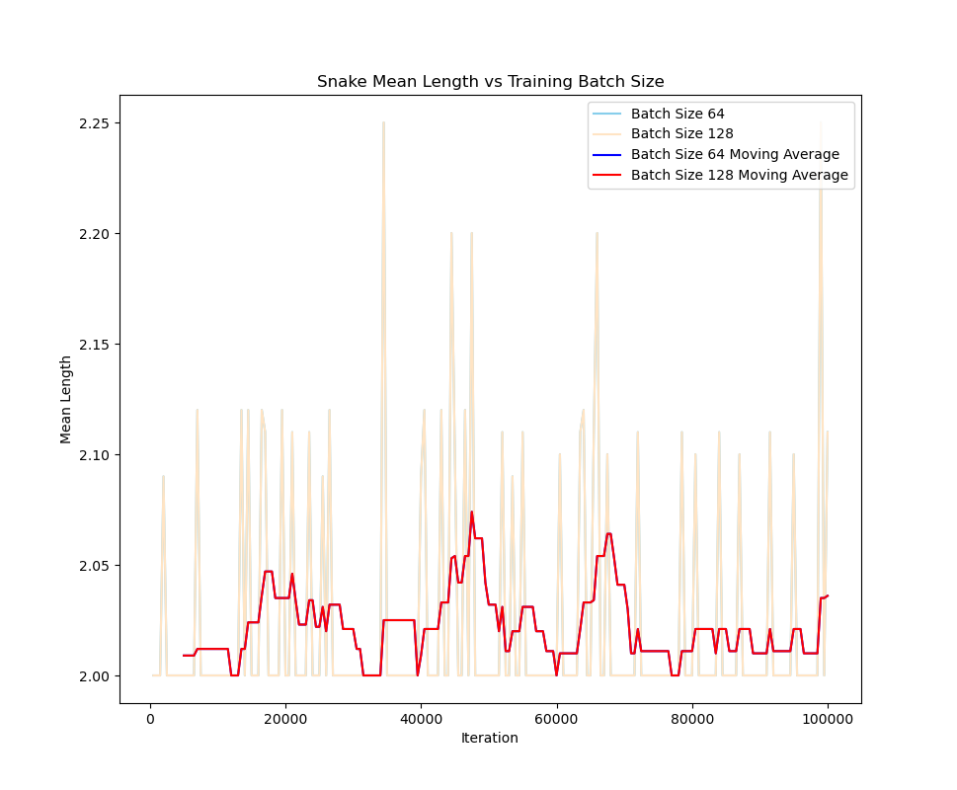
4. Results: Length vs. batch size
Params:
200 000 episodes
DeepQLearningAgent
Discount rate: 1 at beginning, 0. 1 at end

Slide 14
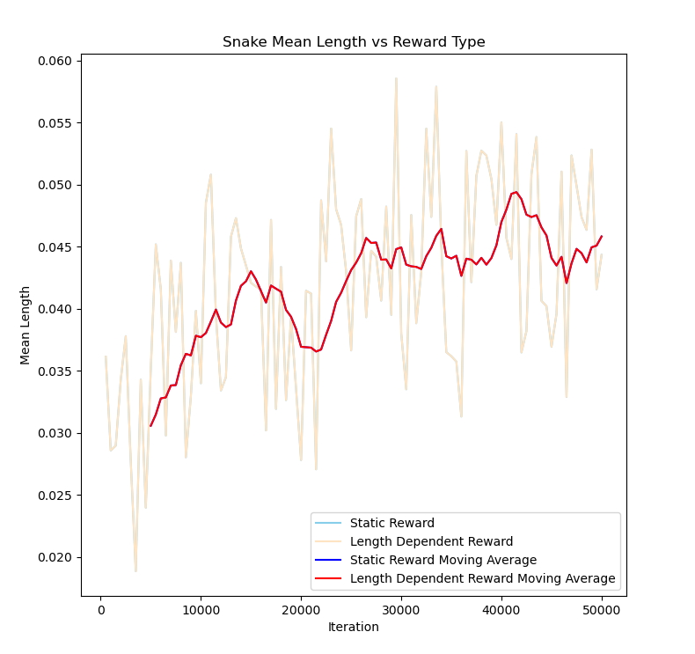
4. Results: Length vs. reward

Slide 15
5. Learning Points
Learning Points:
Took a while to figure out the use of the correct Pytorch equivalents for Tensorflow. Pytorch.org was helpful.
Folder structure – could have cleaned up the folder structure and removed unnecessary models (previous versions) easlier.
The model does learn, even if not learning too much.
Was a very fun challange! I remember the game «Snake», so it was fun to mimic it and try implementing a game with PyTorch.

Slide 16
Sources
Chrispresso (2019), «AI Learns to play Snake!», https://www.youtube.com/watch?v=vhiO4WsHA6c
Pytorch.org (2023). “Saving and loading models with Pytorch”. https://pytorch.org/tutorials/beginner/saving_loading_models.html
MathWorks (2023), “Definition rlDQNAgent”. https://de.mathworks.com/help/reinforcement-learning/ref/rl.agent.rldqnagent.html
Tensorflow (2023). “Deep Q Learning”, https://www.tensorflow.org/agents/tutorials/0_intro_rl
Pytorch (2023). “Zeroing out gradients in PyTorch”, https://pytorch.org/tutorials/recipes/recipes/zeroing_out_gradients.html

